Slide 1
A Novel Distributed Software Architecture for Managing Customer Behavior Data: A Case Study in Banking Sector
Özer Batu Kargılı
Ahmet Okan Arık
Osman Uygar Köse
Merve Bekler
Assoc. Prof. Mehmet S. Aktas
Notes:
Hi for everyone,
I am merve bekler. I work as a data scientist at Gtech.
I will present proposed paper. The paper is called “A Novel Distributed Software Architecture for Managing Customer Behavior Data: A Case Study in Banking Sector “.

Slide 2
Contents
1
2
3
4
Motivation
Problem deﬁnition and our approach
Evaluation
Evaluation metrics and obtained results
Proposed System
Overall system architecture and its components
Conclusion
Future Work and Q&A
Notes:
These are our contents. I will mention motivation, proposed system, evaluation and conclusion, respectively. (rispektivli)

Slide 3
1
Motivation

Slide 4

Background
360-degree insight
Collect and analyze all customer activities
Notice to authorized
Real Time Big Data Analytics
Complex event processing
Association rule analysis
Micro segmentation based on map-reduce programming model
Anomaly detection
Instant action status detection modules
Challenges
Least eﬀort Maximum eﬃciency
Creating test scenarios
Notes:
Today, many companies need to provide 360-degree insight to make critical business decisions and provide customer-oriented solutions.
Companies obtain both company data and their customers' data from various data sources and use big data processing techniques to extract useful information from large-scale data.
One of these sources is behavioral data sources, called clickstream data, representing visitor interactions on applications or websites.
Clickstream data, which contains much information such as clicks, views, visitor's browser, device information, page loading time, is becoming more critical in creating feasible insights.
This study aims to explain the architecture that enables rapid detection of errors during transactions on digital bank platforms, prevent customer dissatisfaction or loss, manage the problems that occur in different channels through a single track, and analyze the data instantly. This architecture includes collecting continuous stream data, performing machine learning algorithms on them, providing the best solution to the customer, and interacting with the customer as soon as possible.

Slide 5
2
Proposed
System
Notes:
Now, I’d like to discuss proposed system.

Slide 6
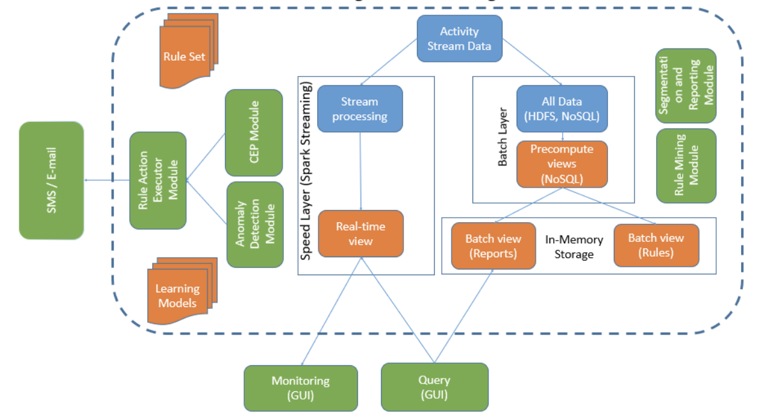
Overall System Architecture
Notes:
Each component of the architecture is shown in this figure. We use lambda-based big data processing architecture, which plays a fundamental role in meeting the big data processing needs. There are three main layers in the proposed architecture for this banking sector: batch layer, speed layer, and serving layer. The batch layer has two main functions: managing all data and pre-computing batch views. The speed layer processes data streams in real-time and deals only with the latest data. The real-time view is available immediately after data is collected.
In this study, we also implemented a digital banking platform to enable testing of the proposed software architecture. For the advanced analytical operations, data was generated using test automation tools. The events, collected as log files, were transferred to the big data processing platform flowing over a publish-subscribe-based message channel.

Slide 7
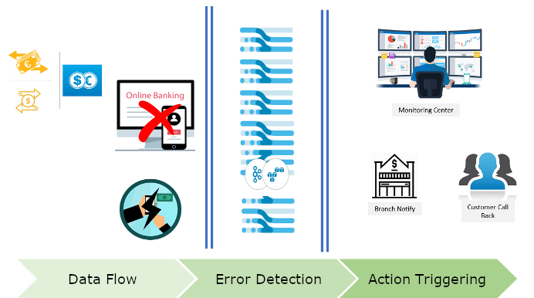
2.1 Modules Utilizing Batch Data Processing
Preprocessing Module
Association Rule Mining Module
Micro-Segmentation Module
EFT, money order error detection scenario flow
Notes:
Modüles utilizing Batch data processing is divided into 3 parts. The first one is…
Preprocessing Module: Data pre-processing methods within the project's scope have been implemented on the Spark platform with the map-reduce programming model.
The other one is..
Association Rule Mining Module: A rule suggestion system has been developed within the scope of this module. While developing this module, FP-Growth, Apriori, Eclat algorithms were implemented/used on the Spark platform.
The last one is…
Micro-Segmentation Module: Within the scope of this module, segmentation functionalities are implemented to identify the customer segments and apply the marketing activities to the appropriate customer group. Segmentation methods are implemented based on map-reduce programming model. Here, we implement K-means and Bisecting K-means unsupervised machine learning algorithms.

Slide 8
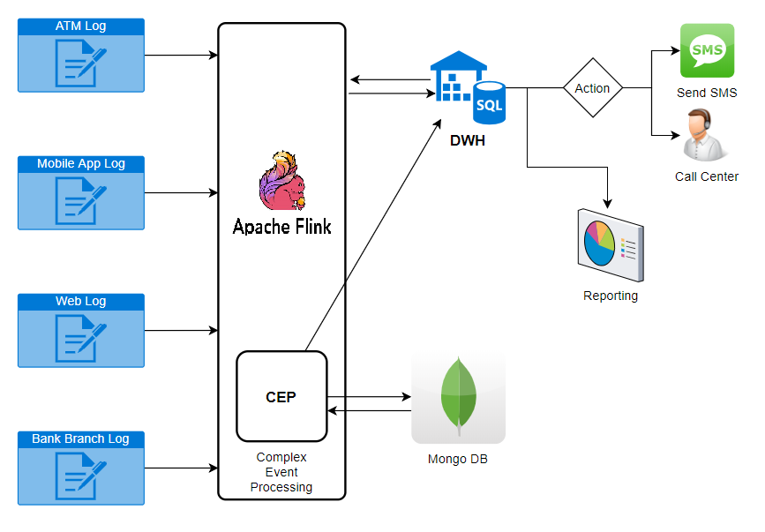
2.2 Modules Utilizing Stream Data Processing
Instant Action Situation Detection Module
Anomaly Detection Module
Rule Engine (Business Process Engine) Module
Data flow schema
Notes:
Modüles utilizing Stream data processing is divided into 3 parts. The first one is…
Instant Action Situation Detection Module: Within the scope of this module, studies were carried out to give instant response actions to the customers as a result of real-time analysis of the errors received by customers while using the bank's digital channels. This module aims to strengthen the communication between the customer and the bank and ensure rapid action against errors in the systems.
The other one is..
Anomaly Detection Module: Within the scope of this module, we worked on classifying the use cases of the platform as "normal use" and "expected use." To understand the activities performed by the customer, anomaly situations are identified by utilizing DBSCAN, PCA, and K-Means algorithms.
The last one is…
Rule Engine (Business Process Engine) Module: All customer transactions performed on digital channels can be processed in the instant action module. The scenarios entered from the system control screens are kept in a cache mechanism used by the instant action module. Thanks to the Rule Engine, users can create instant actions according to business requirements. Rules are created with rule creation forms on the system control screens.

Slide 9
03
Evaluation
Notes:
So, now we’ve come to evaluation section.

Slide 10
01
Response time according to overhead
Metric
Notes:
We conducted various experiments to investigate the performance of the proposed architecture from the perspective of scalability and latency. We choose to response time as a metric.

Slide 11
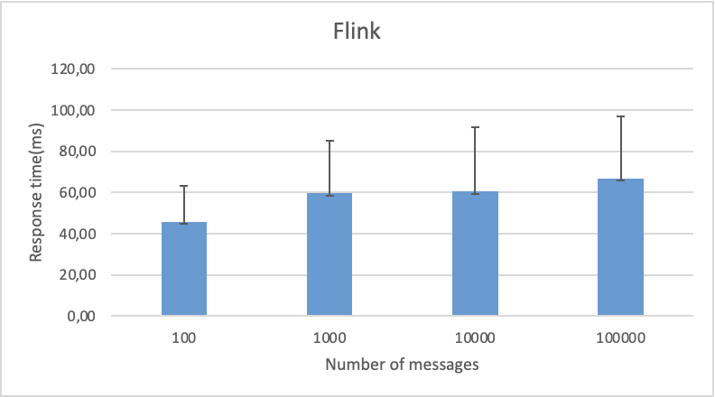
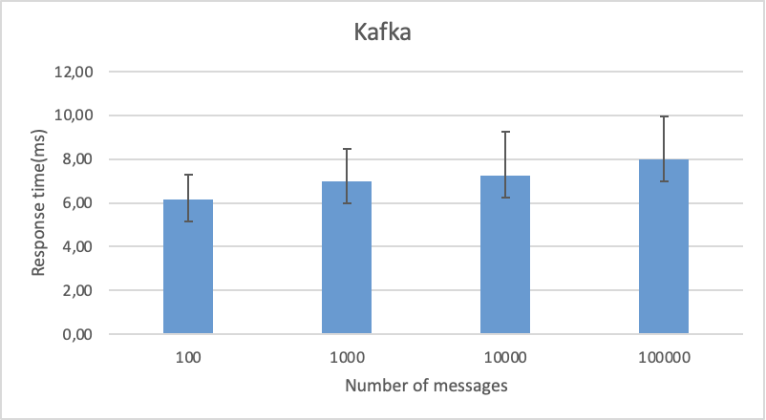
Results
Apache Flink performance test results
Kafka performance test results
Notes:
In the experimental study, we investigate the change the latency in executing the system functions. We also evaluate the scalability of the architectural structure against increasing message loads. We used different message loads such as 100, 1000, 10000, and 100000 events per second. We run the tests 100 times and record average and standard deviation for the observations.
In evaluating the system, the increased workload has been applied to the system, and the maximum number of activities that the system can support was measured. The delay time required for the system to process each event data is also calculated. As a result of the tests, it is understood that the processing overheads of the proposed system are in the order of milliseconds and are negligible.
We leave out the performance analysis of the batch processing-based modules of the system for future study.

Slide 12
04
Conclusion
Notes:
And finally, we’ll look at conclusions.

Slide 13
Conclusion & Future Work
We proposed an abstract design of a distributed system that addresses the requirements of digital banking platforms.
The proposed architecture provides instant and appropriate actions to the right customer at the right time.
We used distributed streaming data processing technique to enable large-scale real-time data analysis.
We developed a rule suggestion system based on the establishment of association rules.
We ran machine learning algorithms on customer clickstream data collected near real-time and detected anomalies on the platform's use cases.
In future studies, we plan to develop the system for different fields such as retail and automotive.
Notes:
This architecture has been designed specifically for a specific domain; in future studies, we plan to develop the system for different fields such as retail and automotive.

Slide 14

Thanks
Contacts
ozer.kargili@gtech.com.tr
okan.arik@yeditepe.edu.tr
uygar.kose@gtech.com.tr
merve.bekler@gtech.edu.tr
aktas@yildiz.edu.tr
Q&A
Notes:
Thank you for listening. If you have any question, we can answer.

